Slide 1


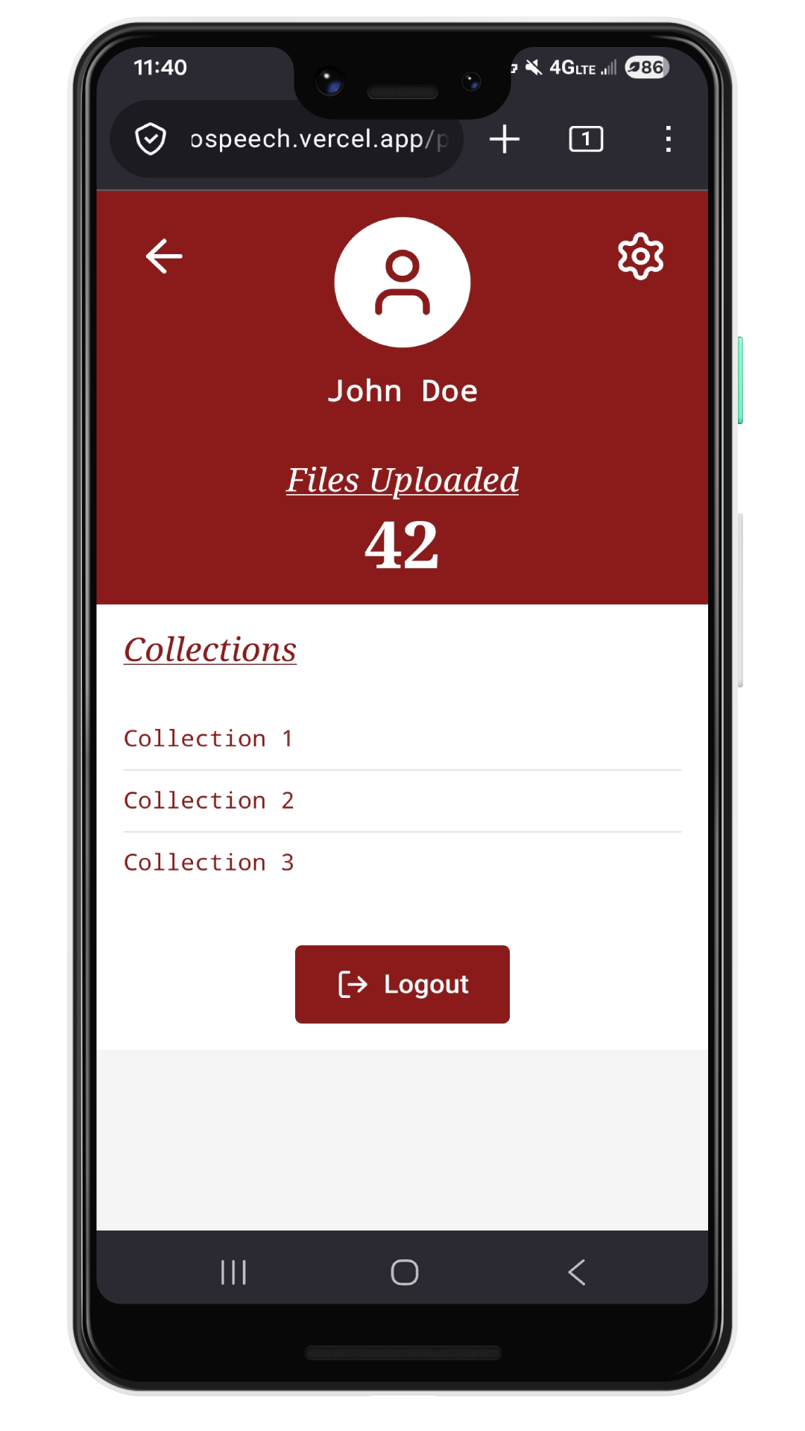
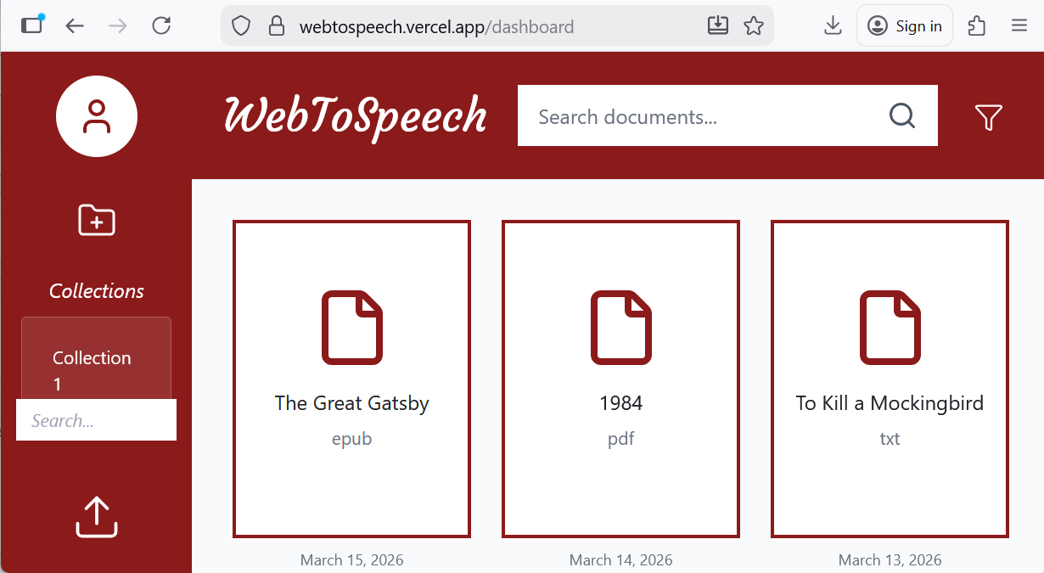
WebToSpeech
Chandler Boone, Danny Lee, John Hurley, Brady Byrd
Dept. Of Computer Science and Information Technology
Abstract
Use Cases
Design
WebToSpeech: a web application designed to provide a simplified, organized reading experience for a wide audience. Users will be able to upload their documents to a database and have them read aloud using text-to-speech synthesis. Organizing a large collection of books and documents can be tedious and disrupt the reading process. To remedy this, WebToSpeech also provides a central hub to organize documents efficiently, sorting them into collections made by the user. Users will be able to create collections by name, add files to those collections, and filter the displayed documents to find only the ones they are searching for. Finally, users will have the option to add annotations and bookmarks to their documents. This will improve the user experience for online document viewing and provide accessibility services to those with reading disabilities.
WebToSpeech will have several use cases. WebToSpeech can provide accessibility options for users with hearing impairment issues. Individuals who suffer from dyslexia and other similar issues can utilize WebToSpeech to make reading easier for them. Users can use the site to play documents in the background as they focus on another task, increasing their productivity.
WebToSpeech features 4 primary pages: the sign in page, the dashboard page, the document page, and the profile page. The sign in page will be a very simple page that will prompt the user to sign in with google. This will be the only way available to sign in and will be handled using Supabase. The dashboard page will serve as a home page for the website. On this page the user will be able to upload documents as well as view documents uploaded prior. The document page is where the user can view the contents of uploaded documents and have the document read aloud to them. This page features controls and annotation options at the bottom of the page. The profile page is where the user can see information about their profile. The number of documents a user has will be displayed here. The user may also adjust their account settings on this page.
Technology
WebToSpeech utilizes several technologies and APIs found online. The website was designed using React. User accounts and data storage is handled by Supabase. The website is hosted online using Vercel. The website utilizes (INSERT API) to handle the text to speech functions of the website.
Figure 1: A mobile view of the profile page of the website
Planned Features
References
If this project were to continue forward, the following features are planned to be added to the website.
A way to share profiles and collections with others
More advanced annotation controls in the document section
More profile options available for users
More file types supported for uploads
React: https://react.dev/.
Vercel: https://vercel.com
Supabase: https://supabase.com
API:
Acknowledgements
We would like to thank Dr. Karen Meisch for her support of students in the College of Science, Technology, Engineering & Mathematics, and Dr. Leong Lee for his support of students in the Department of Computer Science and Information Technology.
Figure 2: A desktop view of the dashboard page

